Slide 1
Managing HUB Repository

Slide 2
AGENDA
ORS Script
Creating ORS
Importing Meta Data
Register ORS
Validate Meta Data
Graphical View Of ORS

Slide 3
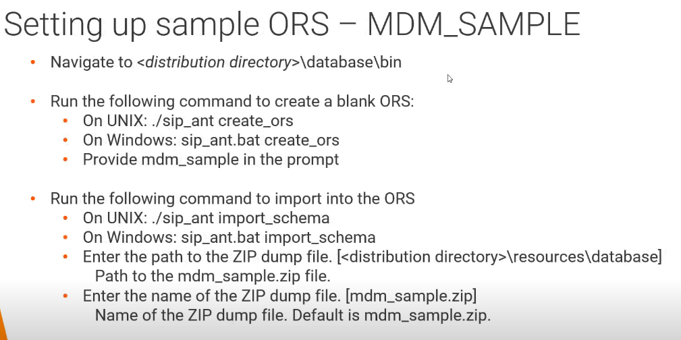
CREATE ORS

Slide 4
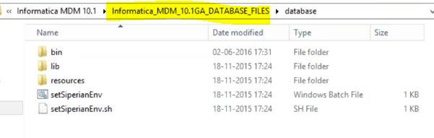
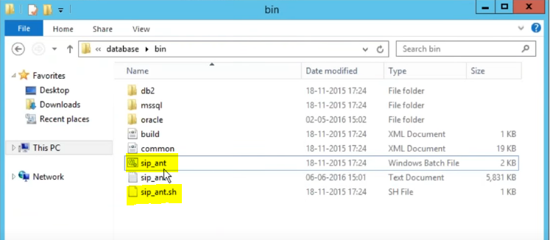
CREATE ORS
Informatica MDM Data Base file.
This you will get as part of Informatica MDM Software.
To Create ORS Data Base Schema Run :
Sip_ant.bat create_ors

Slide 5
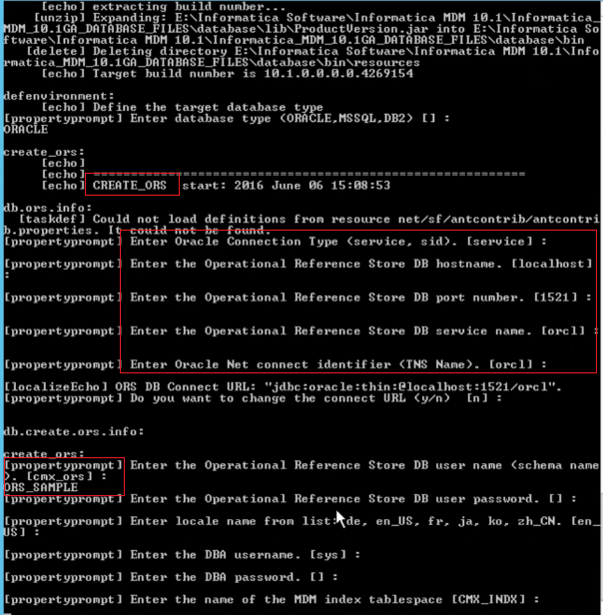
HUB STORE: CREATE ORS
Provide Host, Port, Service etc
Give ORS name like MDM_SAMPLE,ORS_SAMPLE CUSTOMER_ORS etc
An Empty ORS will be created.

Slide 6
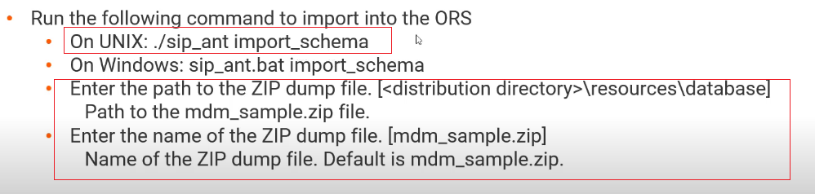
IMPORT ORS:
Run: sip_ant.sh import_schema
Select Sample ORS given by MDM Software bundle

Slide 7
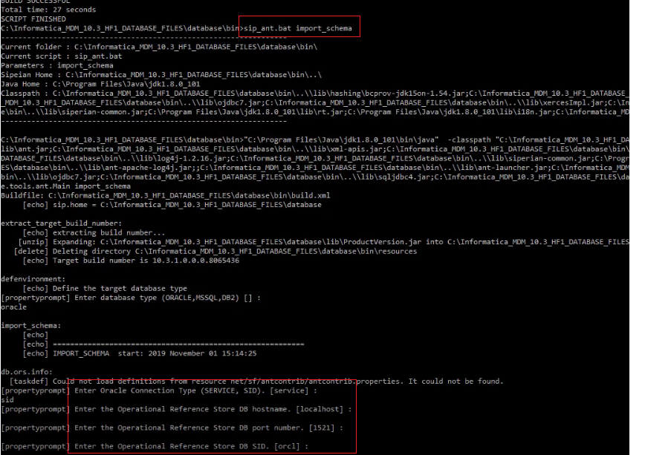
IMPORT ORS:
Sip_ant.sh import_schema
Give ORS name as : MDM_SAMPLE

Slide 8
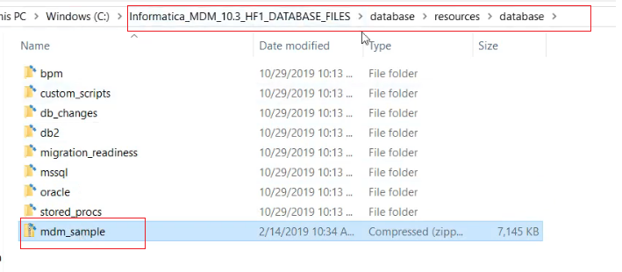
IMPORT ORS:
PATH to Locate MDM Sample ORS.

Slide 9
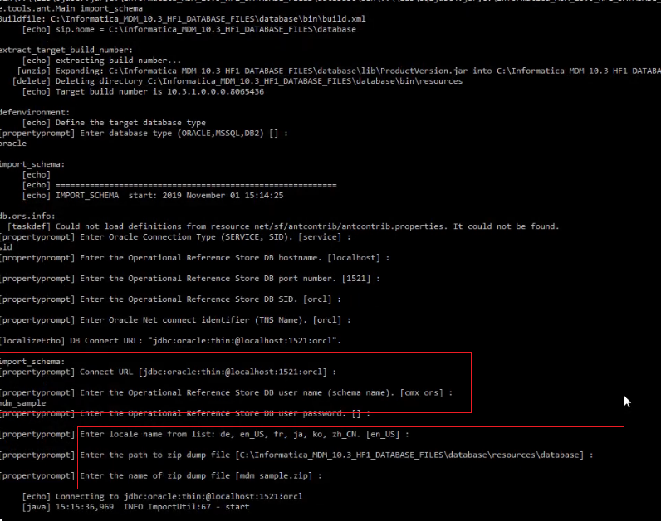
IMPORT ORS:
Provide Sample ORS Info
PATH
Name etc
ORS NAME
SMAPLE ORS PATH

Slide 10
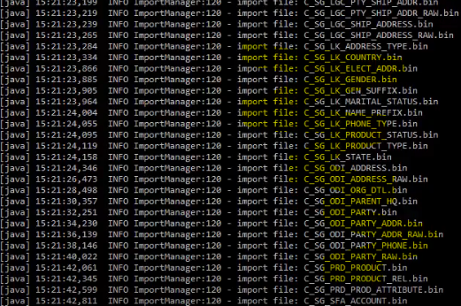
IMPORT ORS:
It will start Importing all Metadata table and Sample tables into the ORS.

Slide 11
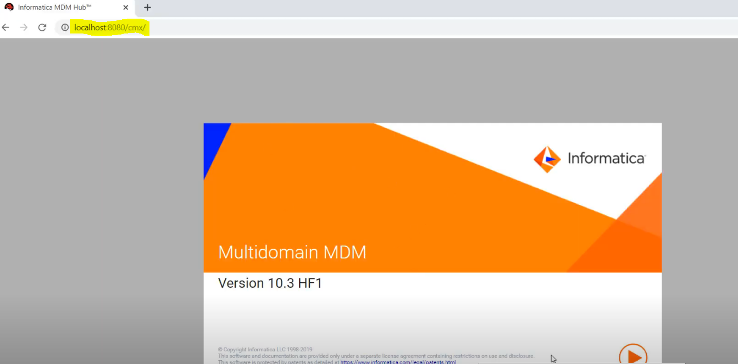
HUB CONSOLE
To Lunch Hub Console
Use any web browser, and enter
<HOST>:<PORT>/cmx/

Slide 12
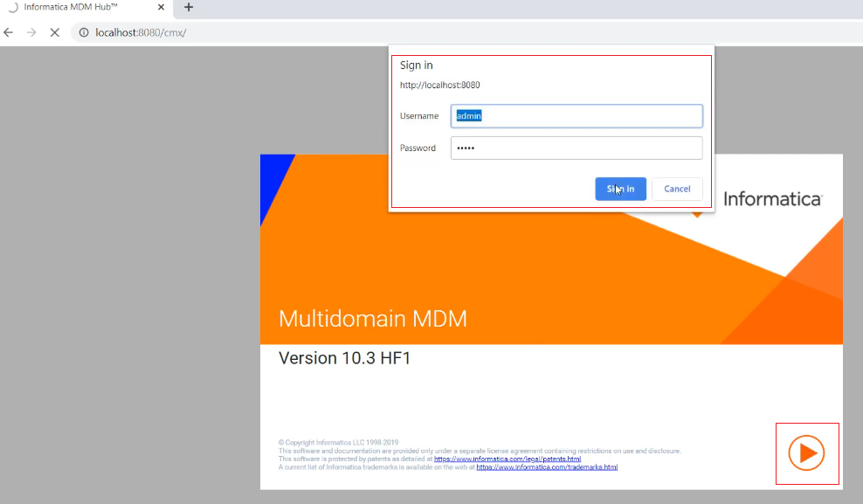
HUB CONSOLE
Provide Sign In Info

Slide 13
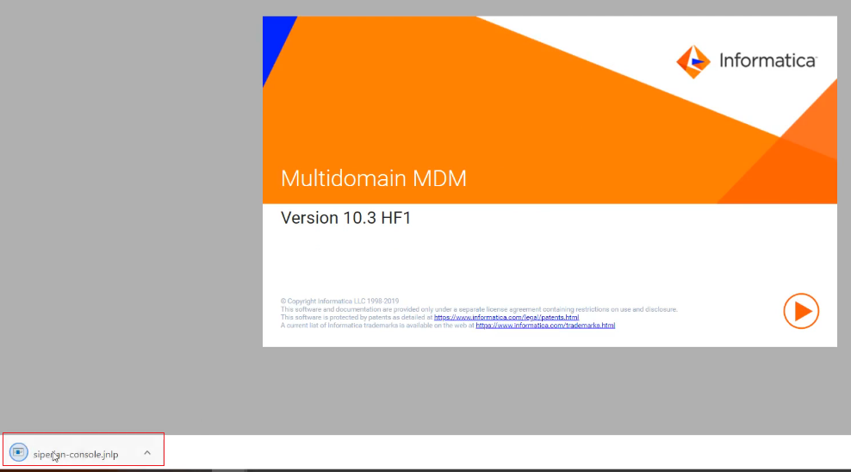
HUB CONSOLE
Siperian-console.jnlp file will be downloaded.
Double click on this to lunch Hub Console

Slide 14
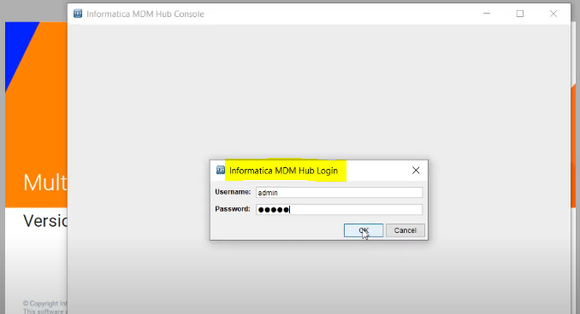
HUB CONSOLE
Provide Login Info

Slide 15
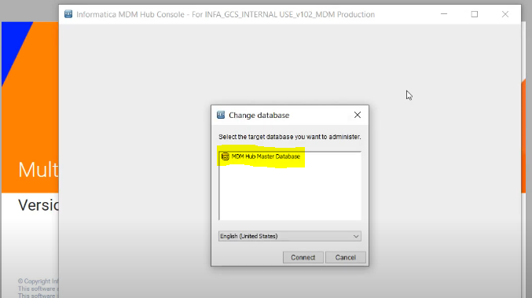
HUB CONSOLE
Only MASTER DB is available.
ORS is not appearing because, we need to Register the ORS first.

Slide 16
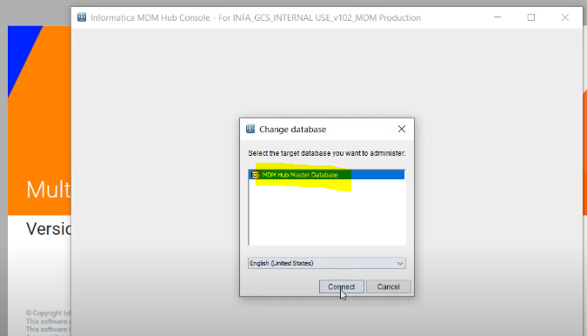
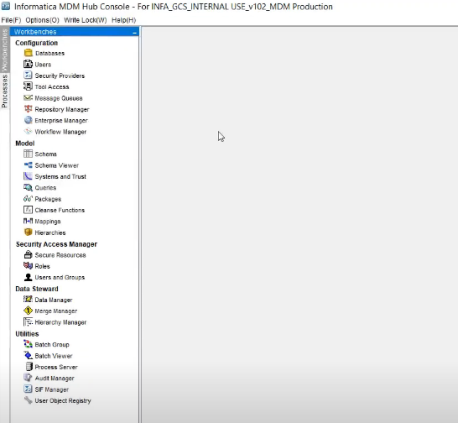
HUB CONSOLE
Select Master DB and login

Slide 17
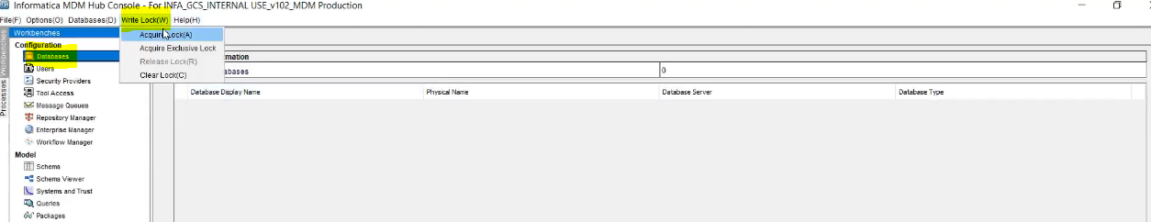
Register ORS:
Go To Database → Acquire Write Lock

Slide 18
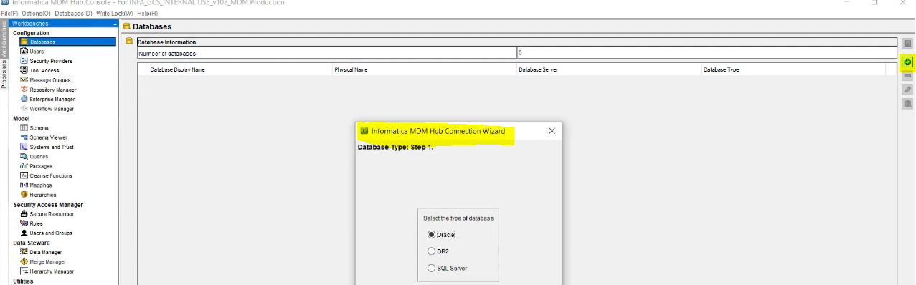
Register ORS:
Click On + add button
Select Database Type

Slide 19
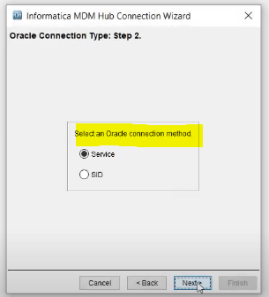
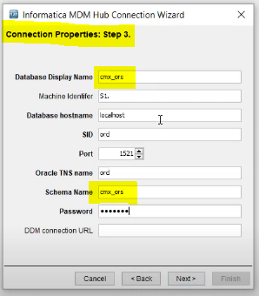
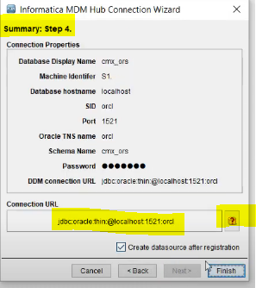
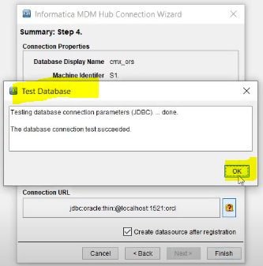
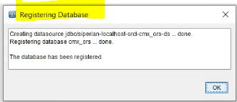
REGISTER ORS:
We have two ORS.
Cmx_ors
Sample_ors
Give both one by one
Review Summary and Test Connectivity

Slide 20
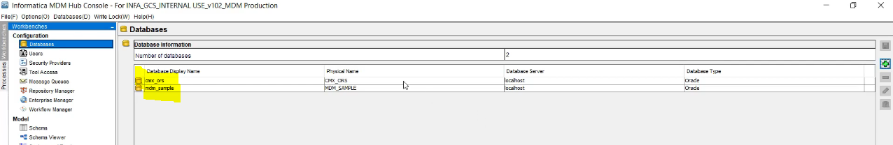
Register ORS:
Similarly Register MDM_SAMPLE ORS.

Slide 21
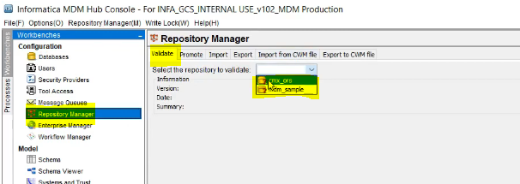
VALIDATING ORS:
Go To Repository Manager → Validate → Select the ORS, which you want to Validate

Slide 22
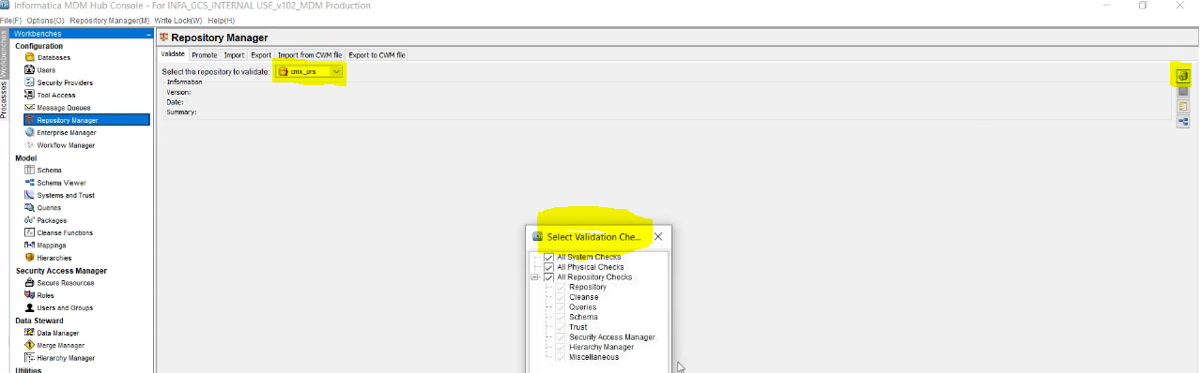
Validate ORS:
Select ORS and Click on Validate Button.

Slide 23
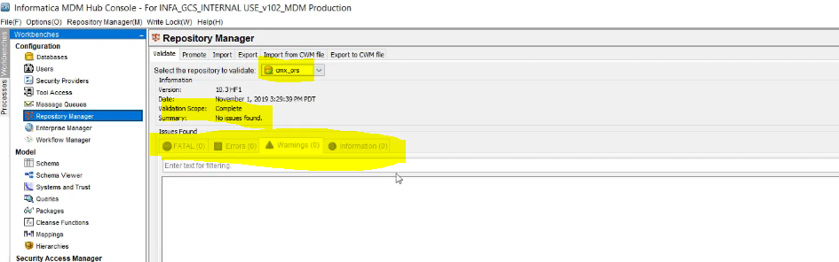
Validate ORS:
No Error Found.
If you get ERROR or FATAL then look into the issue and resolve it.
Like this validate all ORS which you have registered.

Slide 24
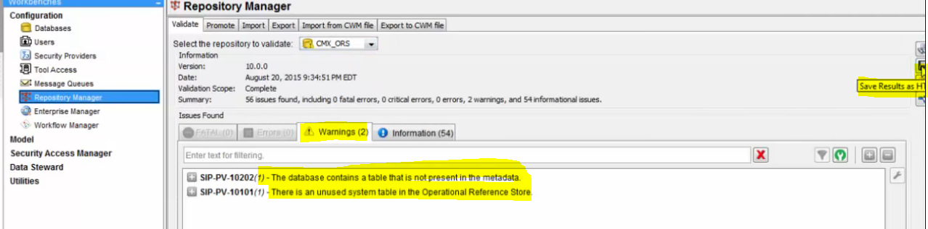
Validate ORS:
Following Validation Shows Warning.

Slide 25
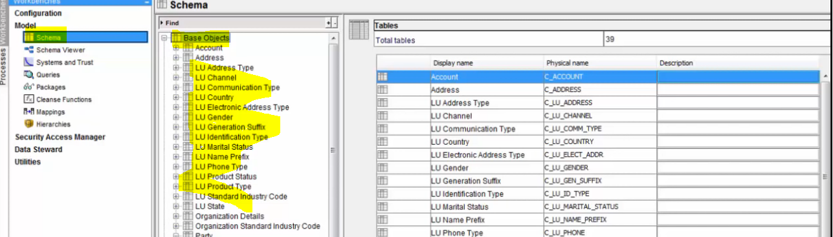
Graphical View Of Repository:
Graphical View is showing entire MDM DB Model in Graphical way.
Below is one of MDM ORS, where we have created Tables based on need.

Slide 26
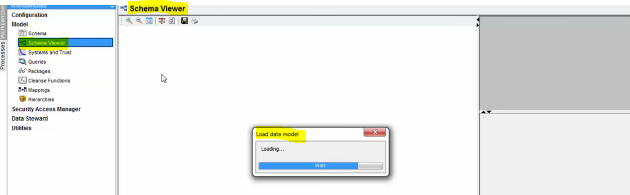
Graphical View Of Repository:
For Graphical View Of Repository : Click on “Schema Viewer”

Slide 27
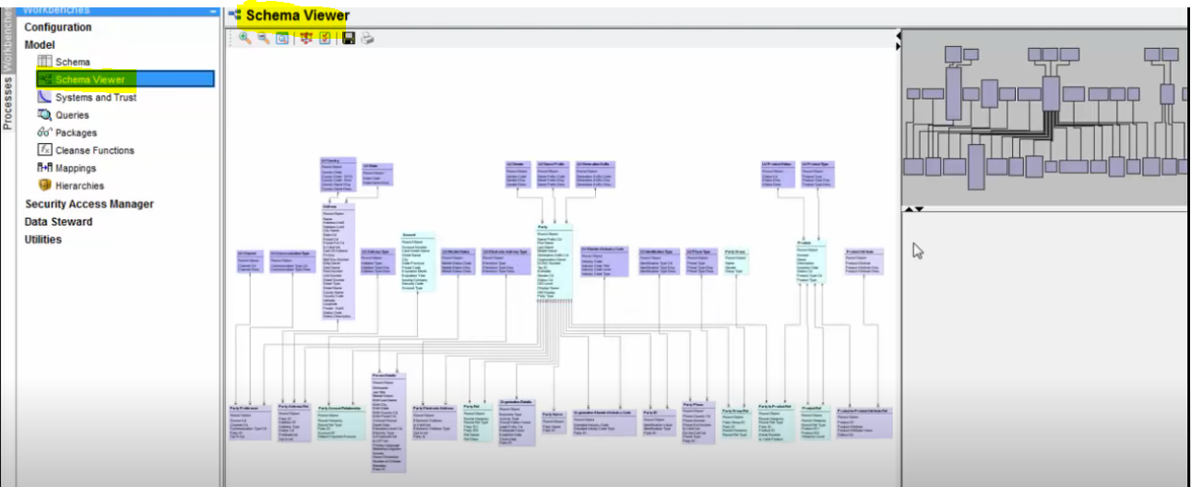
Graphical View Of Repository:
Below is Graphical View Of Repository
You can Zoom In and Out, Can save the schema Viewer, You can Print this also

